Slide 1
CDFI Program
By: Mystic Cournoyer & Brianna Bruguier

Slide 2
Native CDFIs – What Are They?
Native CDFI: Native Community Development Financial Institution
CDFI Fund’s Native Initiative Program, which is also known as the Native American CDFI Assistance Program (NACA Program).
Creates jobs, builds businesses, and fosters economic self-determination in Native Communities.*
Awards Financial and Technical Assistance grants; as well as, provide training.*
Primary Mission: to combat poverty and provide opportunity in Native Communities nationwide.
Certified or working towards certification (emerging NCDFI).

Slide 3
Native American CDFI Assistance (NACA) Program Technical Assistance (TA) Grants
Offered to Native CDFIs, Emerging Native CDFIs, and Sponsoring Entities
Sponsoring Entities must demonstrate the ability to create a new entity
Must become a certified CDFI within four years of receiving an award
Yankton Sioux Tribe = Sponsoring Entity

Slide 5
Timeline
Partnered with First Nations Oweesta Corporation to apply for a Technical Assistance (TA) grant.
Application process for the FY 2017 NACA Program TA grant was submitted.
Received Award Letter in the amount of $149, 414.
Assistance Agreement for the grant became available.
September 2016
May 2017
September 2017
February 2018

Slide 6
NACA-TA Grant Awardee
Guidelines
The YST’s Economic Development Department (EDD) will act as the lead tribal department.
EDD will also lead in creation and development of a new entity by applying for the 501(c)3 non-profit status.

Slide 7
YST’s Economic Development Department
Primary Mission
To provide services to the Tribe, Tribal members, and participants in the areas of economic development and entrepreneurship. EDD seeks to provide all necessary funding, capital, and education to assist in the successful development of Tribal projects and Tribal member-owned businesses.

Slide 8
NACA-TA Grant Awardee
Assistance Agreement
Grant monies must be used for the following activities:
Compensation (Personnel Services/Fringe Benefits)
Training and Education Costs
Travel Costs
Professional Service Costs
Equipment
Supplies
Must ensure goals and measures as outlined in the assistance agreement are met. These include:
Expending the grant set forth and completing the activities no later than 9/30/21.
MUST establish a legal entity that will be certified as a CDFI by 9/30/20.

Slide 9
Goals and Measures
YSTs EDD partnering with First Nations Oweesta Corporation will provide multiple services outlined in two phases to complete the goals and measures for the grant.
Phase I
Community Snapshot Market Analysis
501(c)3 Application Preparation
Phase II
Organizational Policies Development and Job Descriptions
Underwriting Training

Slide 10
NACA-TA Grant Awardee
Purpose
Support the developmental activities needed to create and launch the YST Native CDFI; which will be a non-profit loan fund limited liability company.
Build the organizational capacity to be able to operate independently.
This non-profit tribal NCDFI loan fund limited liability company will be called . . . .

Slide 12
Market Analysis – A Community Snapshot
In early 2018, First Nations Oweesta Corporation partnered with Sweet Grass Consulting, LLC. on behalf of the Yankton Sioux Tribe to conduct a market analysis.
Conducted within a 150 mile radius of the tribal headquarters to investigate the feasibility and understand the potential impact that a NCDFI could have on tribal and non-tribal community members.
Sought to determine the opportunities and services the Ihanktonwan Fund, LLC. could provide to address the challenges and barriers which impact people’s ability to access formal banking, financial services, and capital.

Slide 13
Target Market The loan fund will provide products and services to residents within a 150 mile radius of the tribal headquarters.
Yankton Sioux Reservation is highlighted in red. The expected Target Market is highlighted in blue.
Includes: Yankton Sioux Reservation, Charles Mix County; City of Mitchell, Yankton, and Sioux Falls; and smaller surrounding towns.

Slide 14
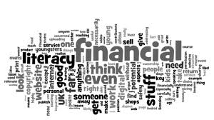
Market Analysis – A Community Snapshot
Findings and Observations
Consumer Loans and Credit Building Opportunities
Lack of funding sources and meeting loan qualifications to become a business owner
Lack of jobs and housing are barriers to employment
More diversity in business and services
Financial literacy, financial coaching, and credit counseling
Financial Education for the youth
Credit Builder Loan Program
Community Garden and Agricultural Development
Microenterprise Lending
Business management and entrepreneurship training

Slide 16
Ihanktonwan Fund, LLC.
The Ihanktonwan Fund, LLC. will be chartered under the Tribe preserving Tribal Sovereignty.
Provide small business and micro-loans, consumer lending opportunities, and financial and homeownership education to residents within a 150 mile radius.

Slide 17
Products and Services
CREDIT SMART – Credit counseling, business assistance, VITA (Volunteer Income-Tax Assistance), IDAs (Individual Development Accounts), and money management accounts.
FINANCIAL LITERACY SERVICES – Financial education that includes Budget 101 courses.
BUSINESS ENTREPRENEURIAL SERVICES – Workshops and marketing strategies, and bringing outside capital into the community.

Slide 18
Products and Services
HOMEOWNERSHIP SERVICES – Home loans/repair, credit repair opportunities, and homebuyer education.
Coordinated with other lead agencies that include: YSHA, CDFI, USDA, US Veterans Affairs, District III, SD Native American Ownership Coalition Committee, Grow SD, Lutheran Social Services, Section 184, and others.
LENDING SERVICES – Small business lending, mortgage lending, credit builder loans, and consumer loans.
Ihanktonwan Fund, LLC. has been provided the opportunity to take on the tribe’s current lending program to assist participants in building their credit.

Slide 19
Ihanktonwan Fund, LLC.
NEXT STEPS:
Set-up General Council meeting to review/approve Articles of Incorporation and Bylaws
Coordinated with Fredericks, Peeble, and Patterson, LLC.
Apply for the 501(c)3 non-profit status, so we can become our own entity! (Finishing Phase I)
Follow with Phase II:
Organizational Policies Development and Job Descriptions
Underwriting Training

Slide 20
Ihanktonwan Fund
Board of Directors
Credit Smart
Services
Credit Rebuilder Courses
Financial Literacy
Services
Business Entrepreneurial Services
Entrepreneurial Workshops/marketing Strategies
Homeownership Workshops
Home loan and repair opportunities and education
Lending Services
Small loan program for credit repair
Ihanktonwan Fund, LLC.
Budget 101
Courses
General Council

Slide 21
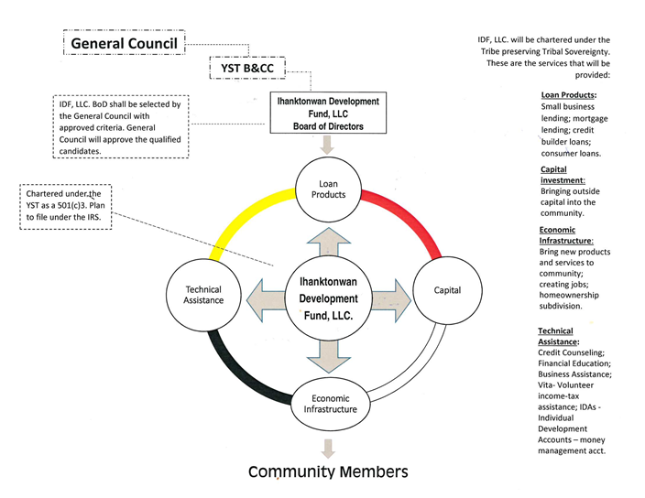

Slide 22
Our Team
Mystic Cournoyer
Economic Development Director
Brianna Bruguier
Loan Processor/Client Relations Specialist

Slide 23
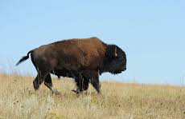
Strengthening
and Empowering
Communities
Thank You

